Slide 1

AI-Based Network Intrusion Detection System
AADITYARAM S
AICTE ID :APPLY_1764311480692941b85bd5c

Slide 2

PROBLEM STATEMENT
Conventional security methods like firewalls and rule-based intrusion detection systems use signatures to defend against malicious activity. However, these methods are not effective when it comes to the latest sophisticated cyber-attacks like Distributed Denial of Service (DDoS) attacks, port scanning, and BotNet-driven traffic attacks. This is because the threat actors keep on changing the signatures continuously; therefore, the system is not able to cope with the new attack signatures.
Further, rule-based systems generally have the problem of high false positives, overwhelming the analysts. Also, rule-based systems do not possess the capacity to process massive network traffic effectively. This is important in modern high-speed networks.
Hence, there arises an increasing need for developing an intelligent, data-driven intrusion detection system that has the ability to automatically learn normal as well as malicious network activities. This process can easily be achieved using machine learning algorithms, which, in turn, will enable the system to properly identify malicious network activities.

Slide 3
Project Description
With the rapid growth of internet usage and cloud-based services, computer networks have become a critical target for cyberattacks. Organizations face constant threats such as Distributed Denial of Service (DDoS) attacks, port scanning, malware propagation, and botnet-driven intrusions, which can compromise data confidentiality, system availability, and network performance.
Conventional security solutions, including firewalls and signature-based intrusion detection systems, are limited in their effectiveness. These systems depend on predefined rules and known attack signatures, making them incapable of detecting unknown or zero-day attacks. Additionally, they struggle to scale with large volumes of high-speed network traffic and often produce a high rate of false positives, increasing the workload on security administrators.
As cyberattacks continue to evolve in complexity and frequency, there is a strong need for an adaptive and intelligent intrusion detection mechanism. Machine Learning–based intrusion detection systems address these challenges by learning patterns from historical and real-time network traffic data. By analyzing flow-based features and statistical characteristics of network behavior, such systems can automatically distinguish between benign and malicious activities.
The objective of this project is to design and implement an AI-Based Network Intrusion Detection System that utilizes machine learning algorithms to accurately identify malicious network traffic in real time. The proposed system aims to improve detection accuracy, reduce false alarms, and provide an efficient and scalable solution for modern network security challenges.

Slide 4

WHO ARE THE END USERS?
Network Administrators
Cybersecurity Analysts
IT Security Teams
Educational Institutions (for learning and research)
Organizations monitoring internal network traffic

Slide 5

Technology Used
Programming Language: Python
Machine Learning Algorithm: Random Forest Classifier
Libraries and Tools: Pandas, NumPy – Data processing, Scikit-learn – Model training
Streamlit – Web dashboard
Matplotlib, Seaborn – Visualization
Dataset:
CIC-IDS2017 (Canadian Institute for Cybersecurity)
IDE:
Visual Studio Code

Slide 6
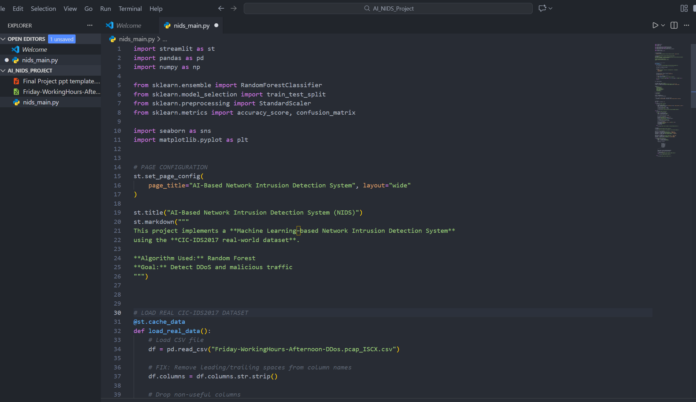
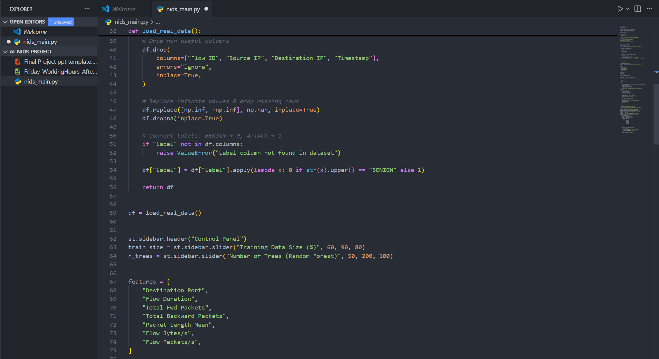

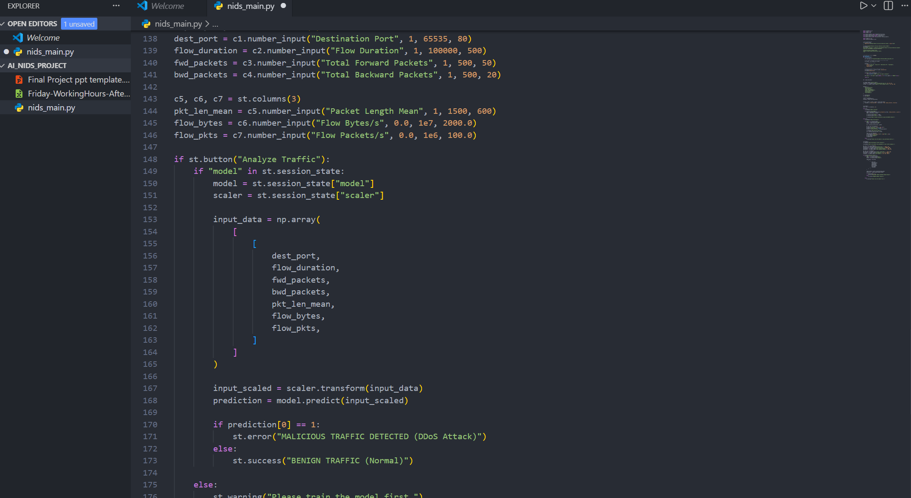
RESULTS
Demo Link: https://drive.google.com/file/d/13W_jlJal3ILmOg7UA4Q70HHbWnOUJUMM/view?usp=sharing

Slide 7
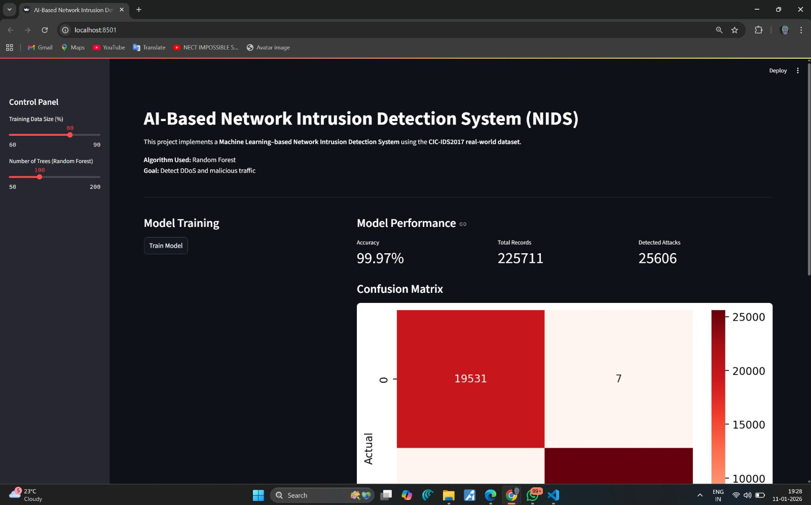
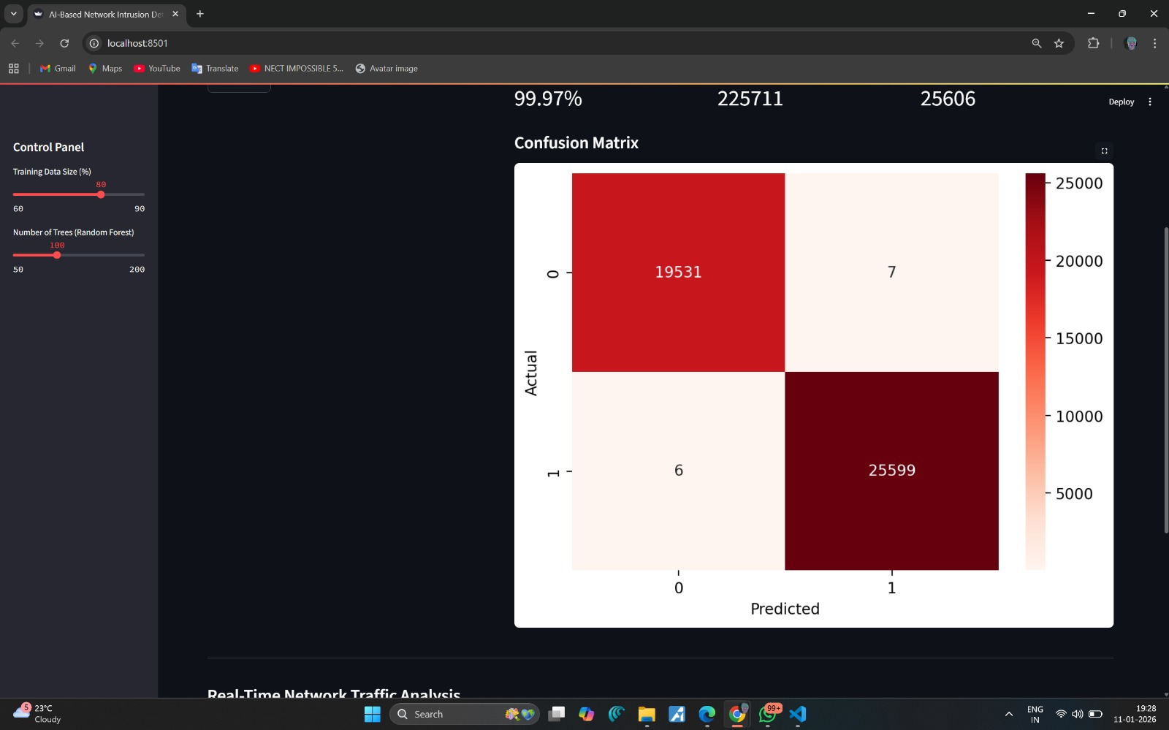
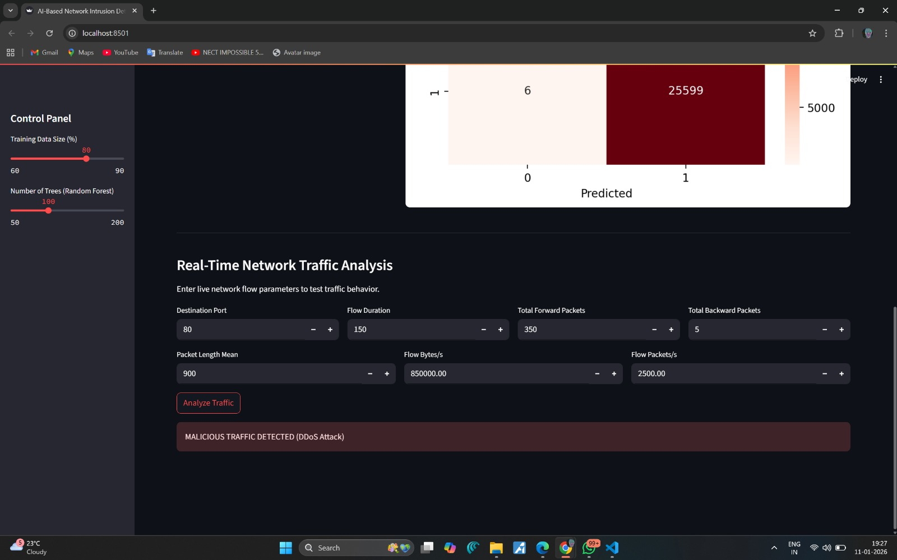
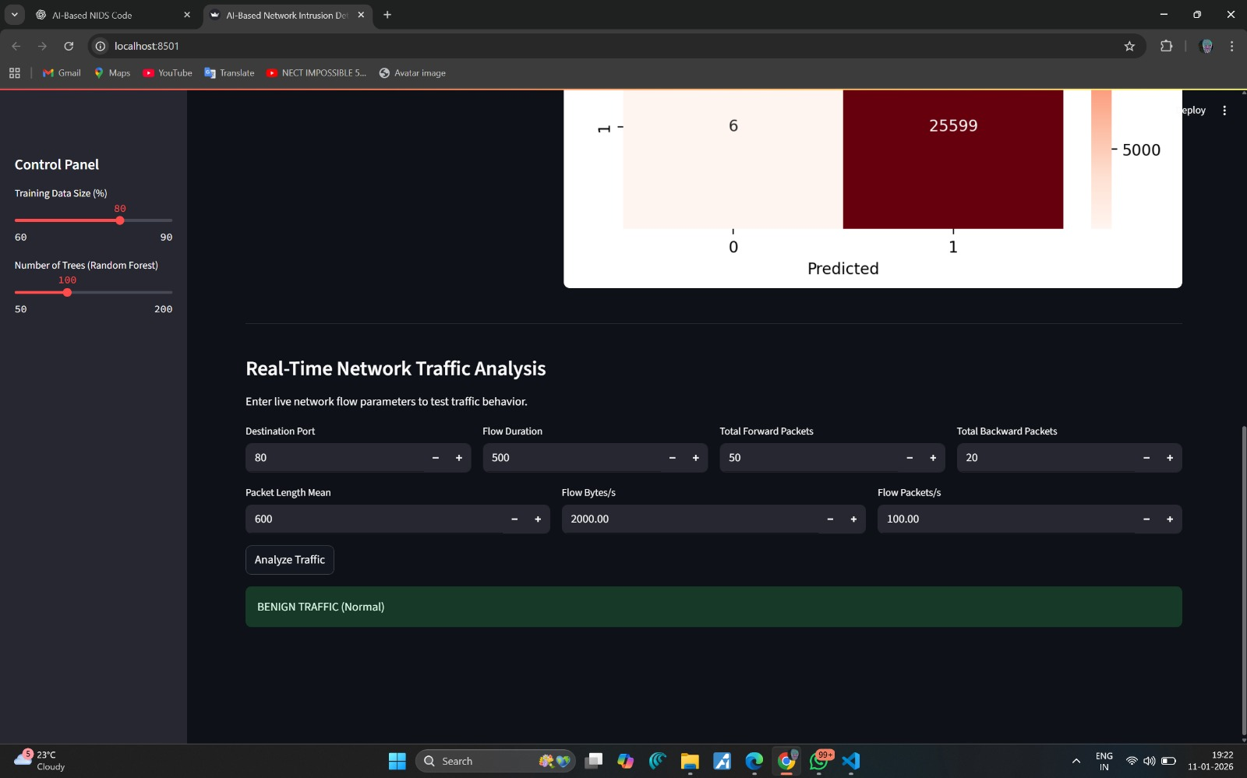
RESULTS
Demo Link: https://drive.google.com/file/d/13W_jlJal3ILmOg7UA4Q70HHbWnOUJUMM/view?usp=sharing

Slide 8

Certificate - Protection from browser attacks

Slide 9

Certificate - Introduction to System Security

Slide 10

Certificate - Securing Android Devices

Slide 11
GitHub link
https://github.com/Aaditya2522/VoisTech

Slide 12
Thank you
.
.

